Slide 1

Corporate Engagement Monitor
Project Partner : Olga Kononykhina, LMU Department of Satistics
Team members: Daria Moiseeva, Shen Fengyan , Yuan Zhengchen, Zhou Tangqian
Supervisor: Rickmer Schulte
Munich, 19/12/2023

Slide 2
Overview:
Background
Goals
Survey Design
Data Evaluation Results
Conclusion

Slide 3

Background
“Monitor Unternehmensengagement 2022” survey by ZiviZ in the Stifterverband and the Bertelsmann Foundation

Slide 4
Goals
Evidence-based understanding of corporate engagement practices in Germany such as :
Embedment of volunteerism within organizations
Dedication to societal well-being
Comprehension of the mutual benefits

Slide 5
Survey Design
Sample survey
Representative according to :
size of a company
industry type
region
1803 companies
Target group : senior managers or the heads of the CSR departments (1 person per company)
Included both open - and close - ended questions

Slide 6
Data Evaluation Results
6

Slide 7
Questions :
1-How do corporate volunteering activities differ among companies of different sizes?
2-Is there a significant correlation between the size of a company and the frequency of their corporate volunteering activities?
6-Can we predict the frequency of corporate volunteering events based on company size and industry type?
3-Do companies within specific industries show a stronger commitment to corporate volunteering compared to others?
4-Is there a difference in the number of engaged employees in the service industry versus the manufacturing industry?
5-Are there discernible patterns in corporate volunteering among companies headquartered in different regions of Germany?
7-Can specific volunteering challenges explain why some companies volunteer less?
8-How do companies' volunteering challenges vary across industries?
9-Are companies that have been in operation for a longer duration more likely to be more engaged compared to newer companies?
10-Are employees in family companies more engaged in volunteering programs?

Slide 8
How do corporate volunteering activities differ among companies of different sizes?

Slide 9
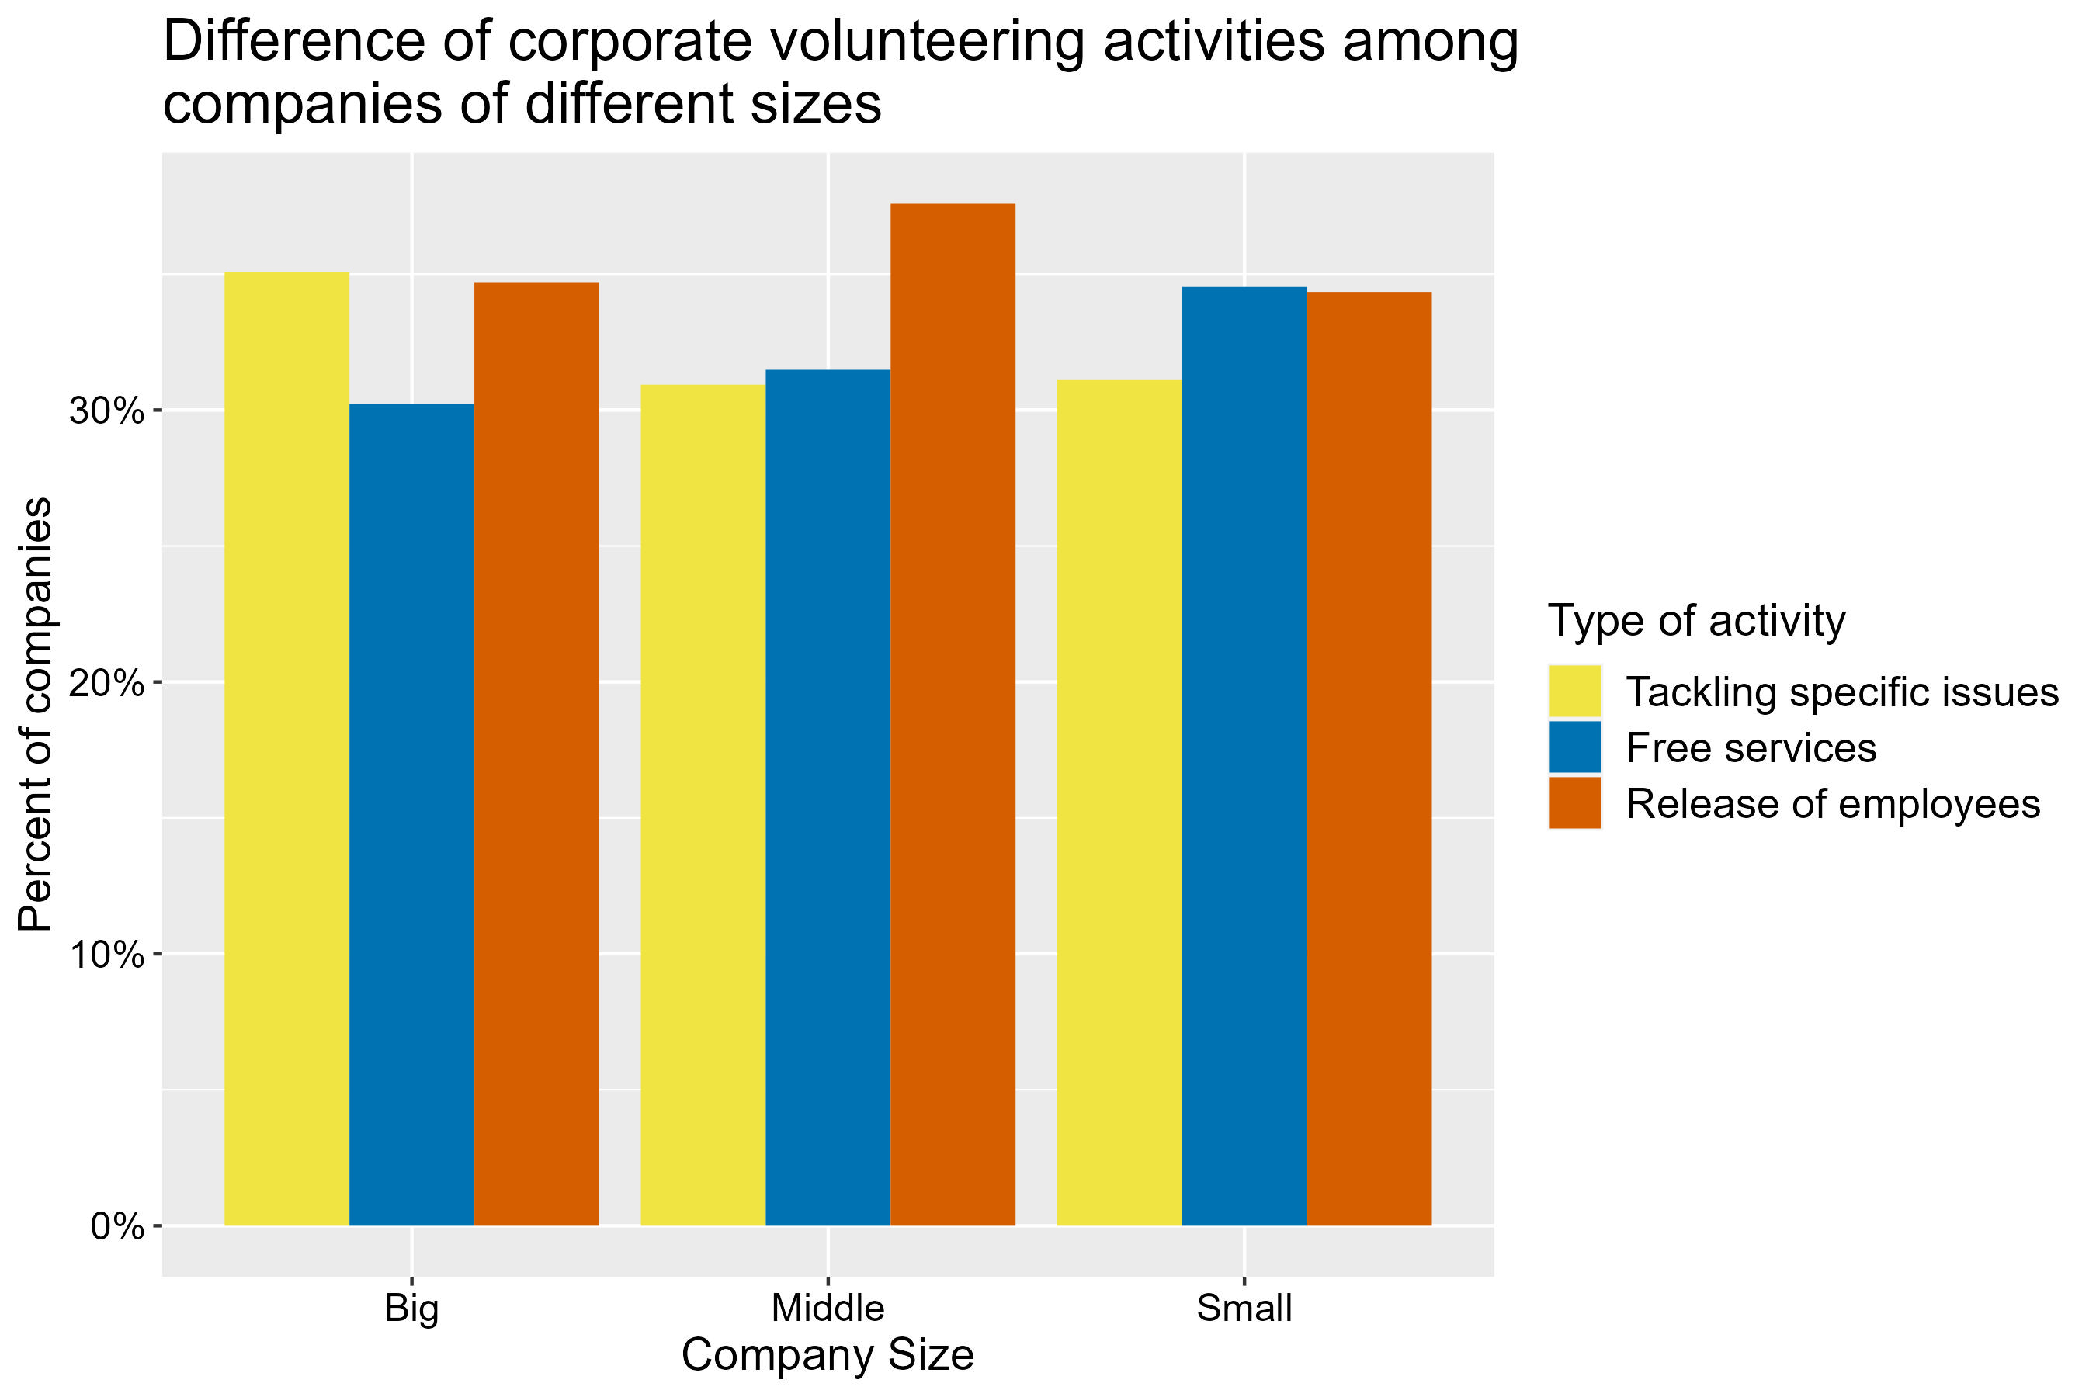

Slide 10
Is there a significant correlation between the size of a company and the frequency of their corporate volunteering activities?
10

Slide 11
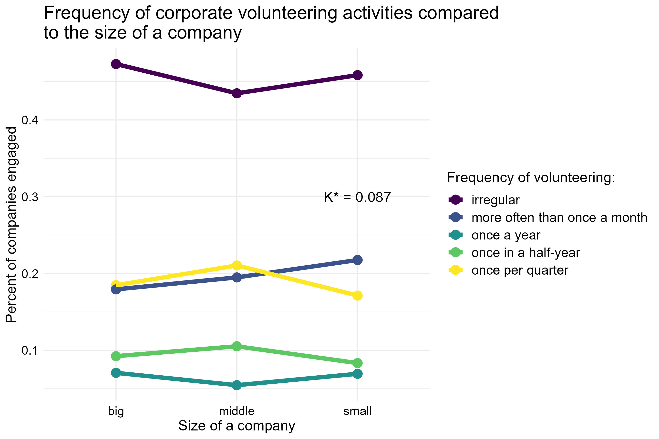

Slide 12
Can we predict the frequency of corporate volunteering events based on company size and industry type?

Slide 13
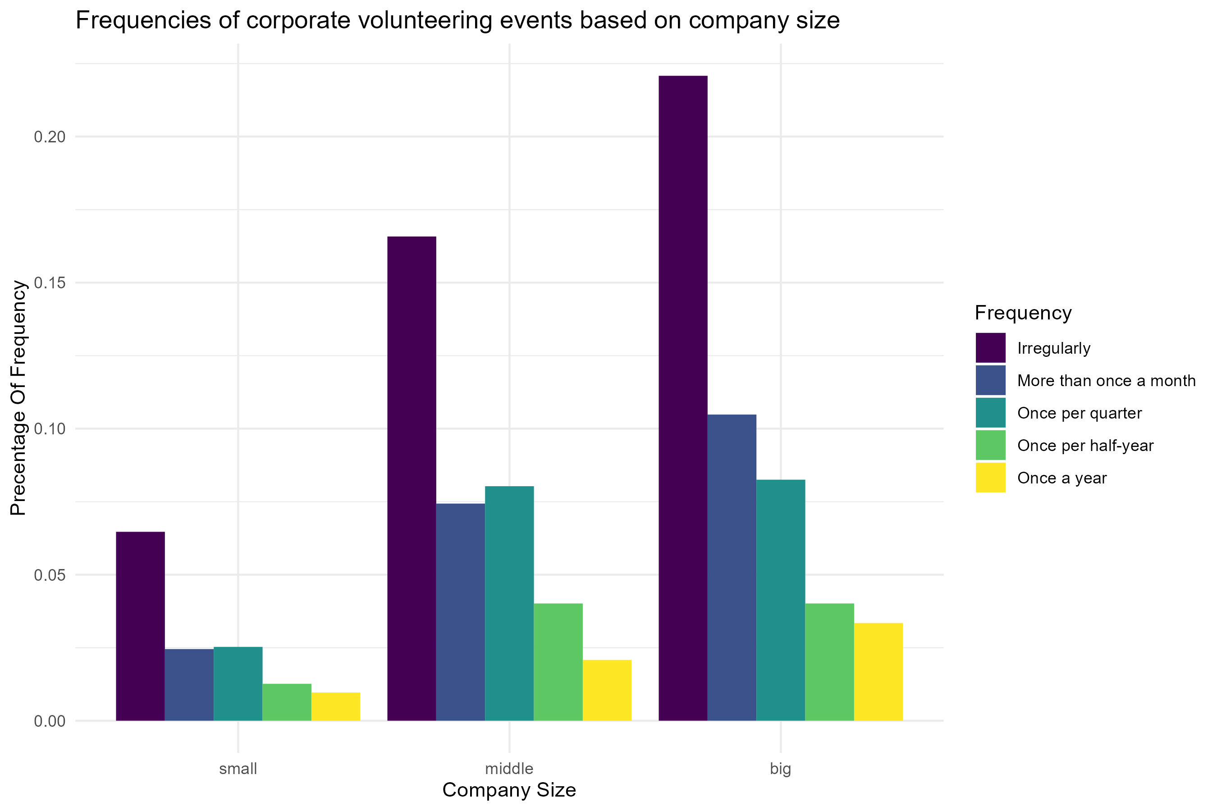

Slide 14
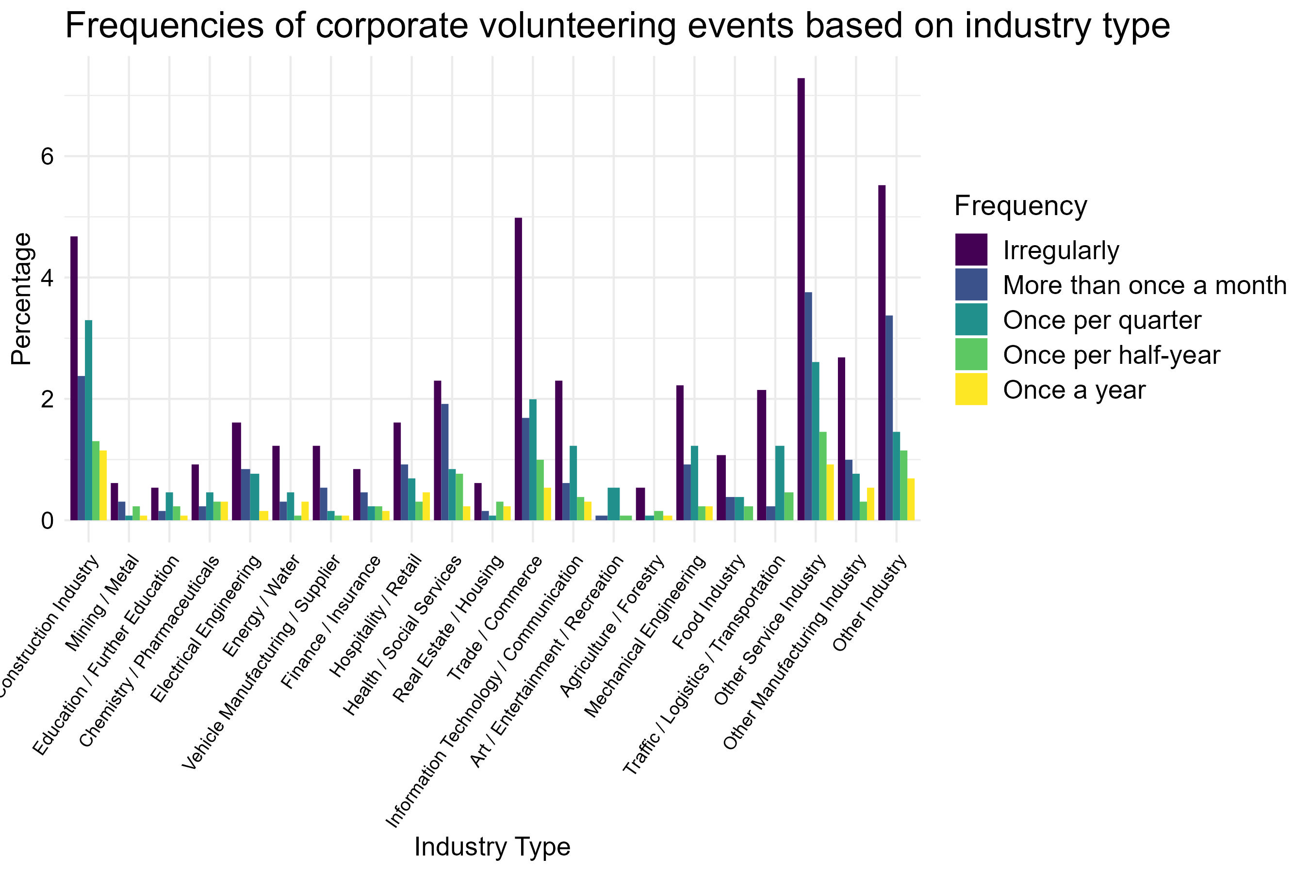

Slide 15
Do companies within specific industries show a stronger commitment to corporate volunteering compared to others?
15

Slide 16
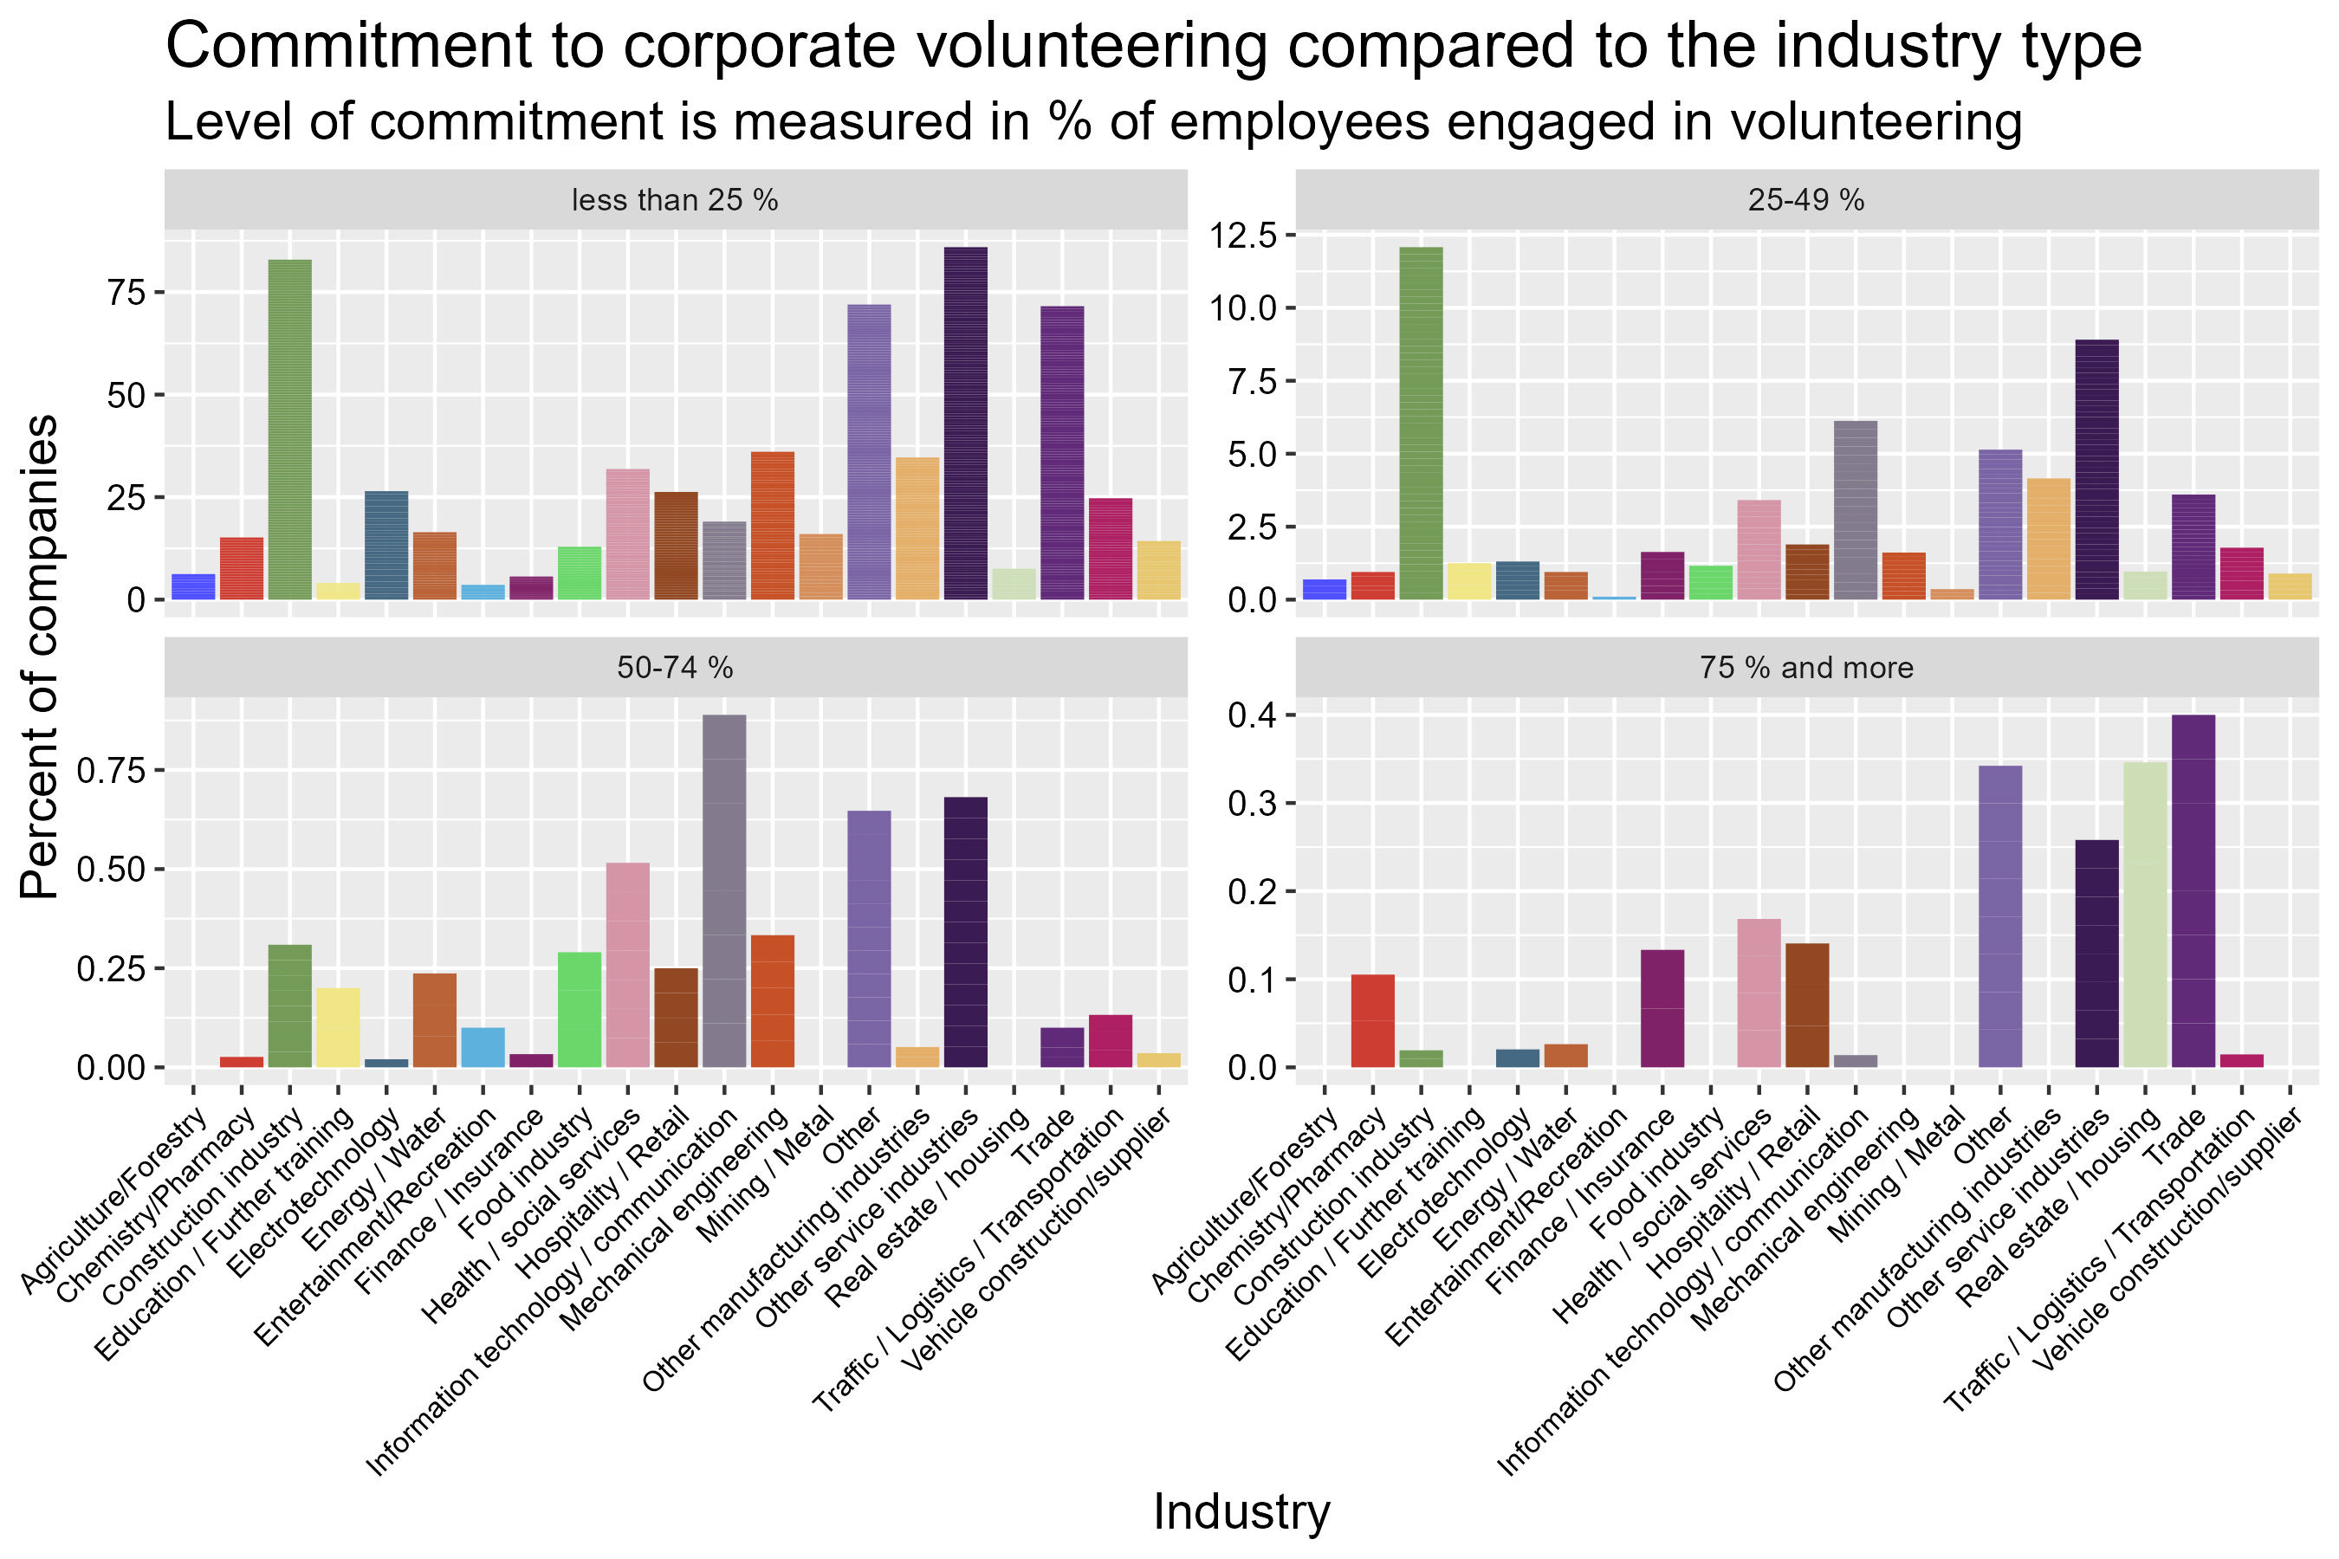

Slide 17
Is there a difference in the number of engaged employees in the service industry versus the manufacturing industry?
17

Slide 18
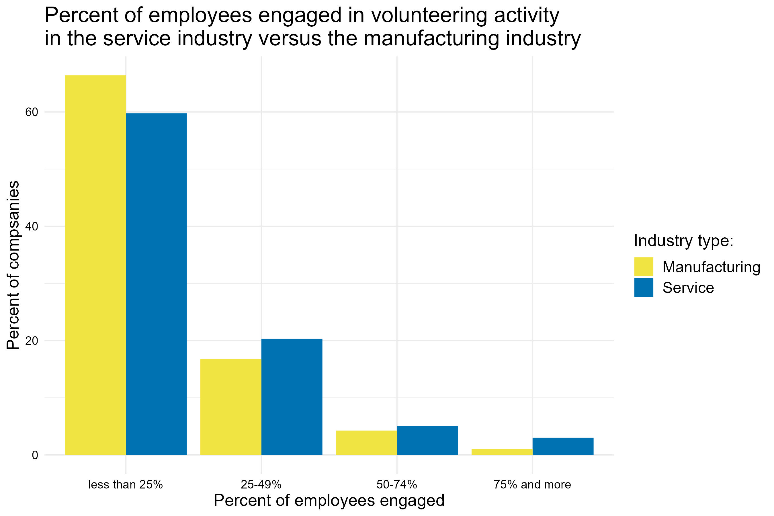

Slide 19
Are there discernible patterns in corporate volunteering among companies headquartered in different regions of Germany?

Slide 20
20

Slide 23
Can specific volunteering challenges explain why some companies volunteer less?

Slide 24
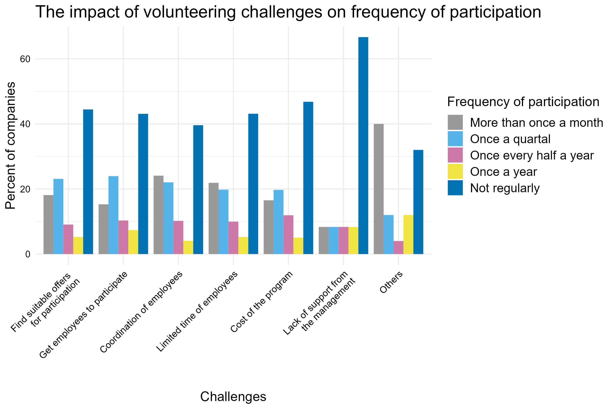

Slide 25
How do companies' volunteering challenges vary across industries?

Slide 26
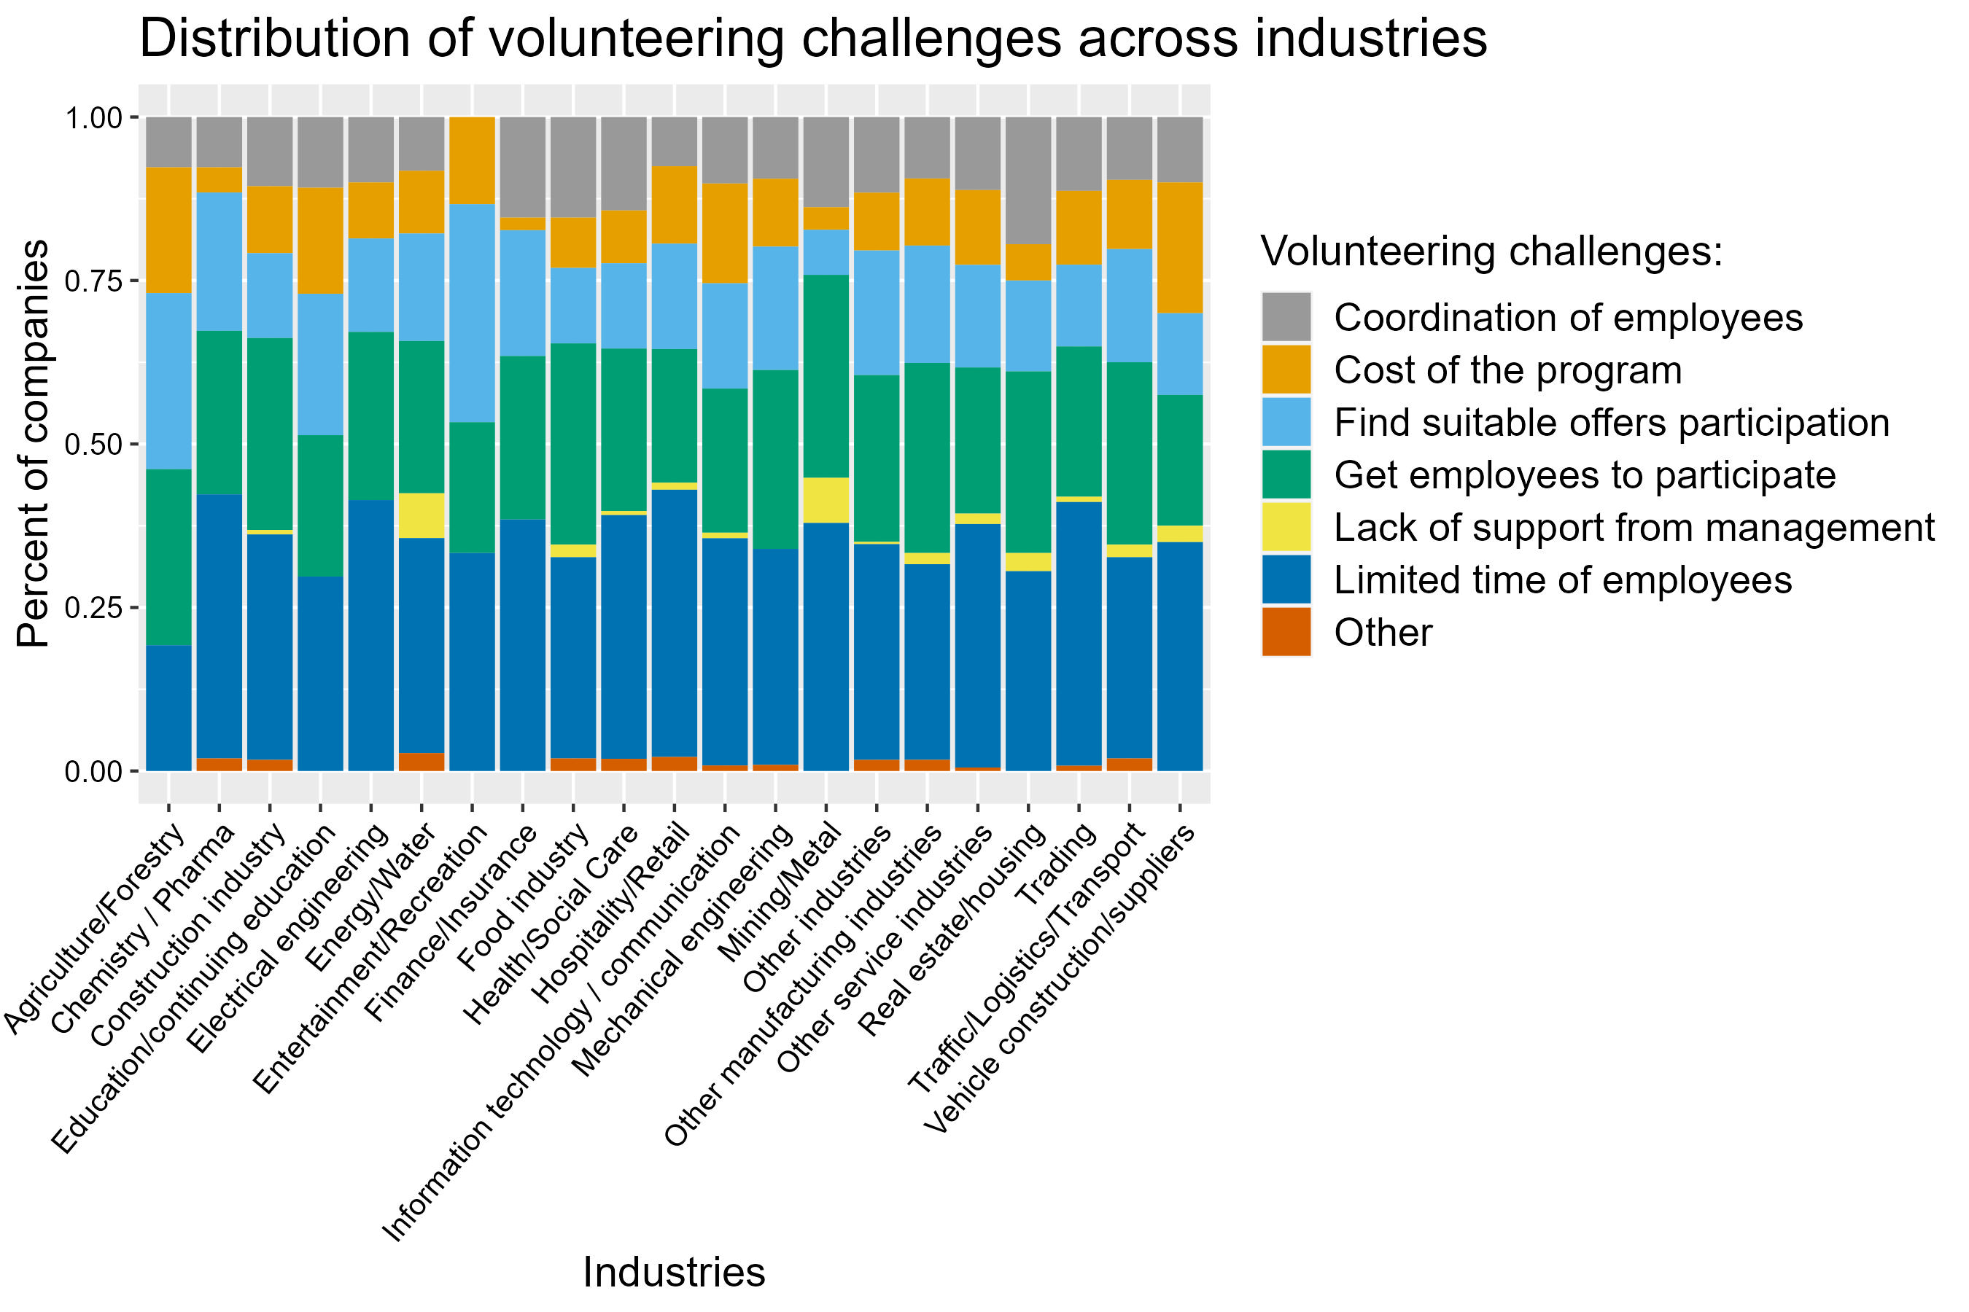

Slide 27
Are companies that have been in operation for a longer duration more likely to be more engaged compared to newer companies?

Slide 28
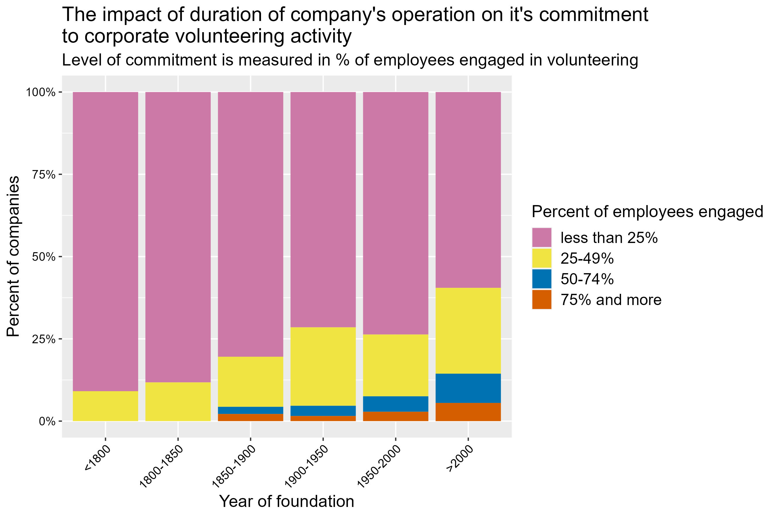

Slide 29
Are employees in family companies more engaged in volunteering programs?

Slide 30
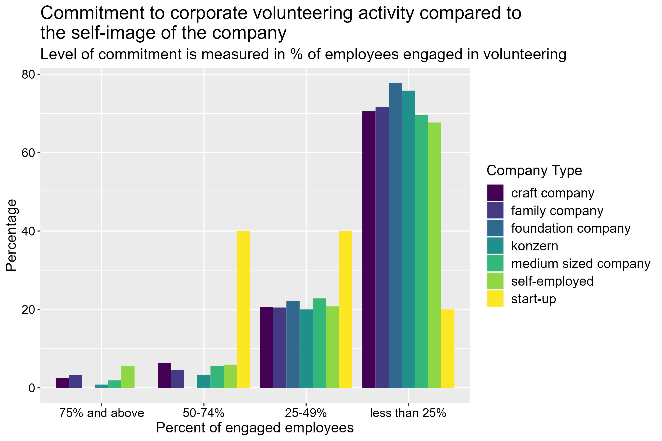

Slide 31
Conclusion

